Slide 1
Summary of Surface Water Budget Components
17 November, 2022
Notes:
National Aeronautics and Space Administration

Slide 2
Learning Objectives
Summarize the water data covered in this training
Describe advantages and challenges of remote sensing for watershed management

Slide 3
Summary of NASA Water Resources Data

Slide 4
Water Resource Management
Over a watershed, basin, or region:
Precipitation (rain, snow) is the main source of fresh water
Other regional contributions: runoff, streamflow, lakes, soil moisture, ground water
Depletion of water comes through:
Evaporation and evapotranspiration through loss of water to the atmosphere
runoff outflow
Surface freshwater availability (W) is largely controlled by:
W = (precipitation + regional runoff ) -
(
)
evaporation
+ runoff outflow + soil moisture + infiltration
evapotranspiration
Notes:
Precipitation is the main sources of freshwater over any watershed/river basin or region. Run Off, ground water, soil moisture, water reservoir redistribute water whereas evaporation and transpiration (due to vegetation) of water to the atmosphere deplete available fresh water.
The fresh water availability over a region can be estimated from the various water components as shown here. Water managers have to use ‘W” amount of water for domestic, agricultural, and industrial needs. Large-scale measurements of these water components are crucial for sustainable water management.

Slide 5
Water Resource Data Applications
Freshwater Components Required
Agricultural & Irrigation Management
Flood & Drought Management
Reservoir & Dam Management
Water Allocation
Water budget
Precipitation
Soil moisture
Evapo-transpiration
Precipitation
Runoff & streamflow
Soil moisture
Evapo-transpiration
Groundwater
Reservoir Height
Precipitation
Runoff & streamflow

Slide 6
NASA Satellites and Models for Surface Fresh Water Components
Freshwater Component | Satellite/Sensor or Model | Spatial & Temporal Resolutions and Coverage
Rain Amount | GPM /(GMI, DPR) & TRMM /(TMI, PR) – IMERG and TMPA Multi-satellite data | IMERG: 0.1°, 65°S to 65°N 30-minute, daily, monthly; 3/2014 to present TMPA: 0.25°, 50°S to 50°N 3-hourly, daily, monthly; 1/1998 to 4/2015 -- also 4/2015-presnt based in TRMM climatology
Soil Moisture | SMAP/(Microwave Radiometer) | 36 km, global daily, monthly, 3/2015 to present
Land Cover NDVI (For ET Estimation) | Sentinel-/ SAR Landsat 7/ETM+ Landsat 8/OLI&TIRS Terra & Aqua/MODIS | 5 km x 20 km, Global; 12-day, 4/2014 to present 30 m, Global; 16-day, 4/1999-present 30 m, Global; 16-day, 2/213-presnt 250m, Global, 16-Day, 2/2000 to present
Runoff | GLDAS- NOAH V2.1 | 0.25°, Global; 3-hourly, monthly; 2000 – present

Slide 7
Advantages and Challenges of Remote Sensing for Watershed Management

Slide 8
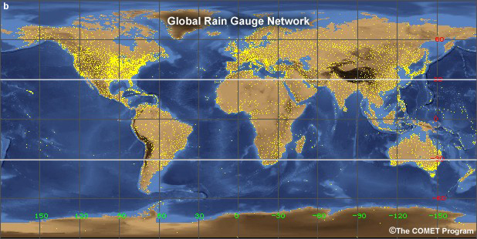
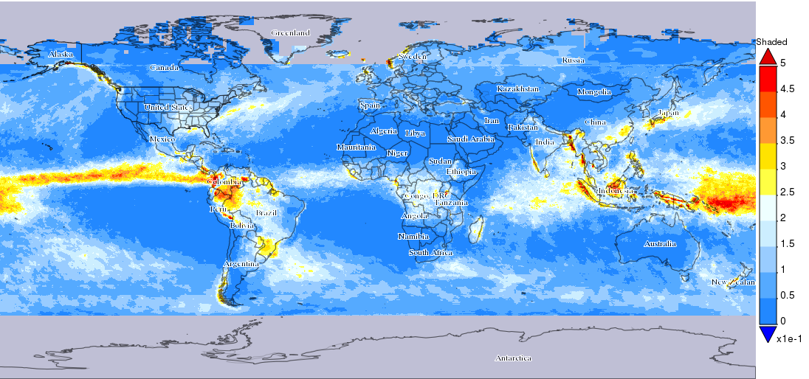
Advantages of Remote Sensing Water Resources Data
Remote sensing-based data provide near-global coverage compared to surface-based, spatially non-uniform point measurements
Provides data where surface-based measurements are unavailable
Earth system models integrate surface-based and remote sensing observations and provide uniformly gridded, frequent information
Earth system models provide parameters that aren’t directly observed by satellites (e.g. runoff, ET)
Data are free and there are web-based tools
Top: Global rain gauge locations. Credit: Introduction to Tropical Meteorology, The COMET Program; Bottom: Annual Precipitation (2015) from NASA GPM
Notes:
Provide global-scale water cycle quantities on hourly, daily, seasonal, and multi-year time scales
All the water components listed here are available from either satellites or models or from both satellites and models. These data can be used not only for estimating available fresh water but can be used to force hydrologic models for more quantitative applications.
All other quantities are available from satellite observations as well as from models
Quantities in green are derived from satellite observations
Quantities in red are from atmosphere-land models in which satellite observations are assimilated

Slide 9
Challenges of Remote Sensing Water Resources Data
All freshwater components are measured by different satellites and sensors with varying spatial and temporal resolutions, coverage, and quality
There is trade-off between spatial and temporal resolutions
Landsat measurements are at 30 m
Sentinel-SAR at 5 km x 20 km, available every 16 and 12 days
GPM-IMERG data available every half hour but have 0.1° resolution
Satellite and model data files are large and in different data formats: training is required to learn how to access them

Slide 10
Challenges of Remote Sensing Water Resources Data
Often additional processing may be needed for specific applications
e.g. Landsat-based ET has to be processed further to fill cloud gaps and also to estimate monthly and seasonal values based on additional information
While the data are generally validated with selected surface measurements, regional and local assessment is recommended
While individual freshwater components based on satellite observations are useful for many applications, accurate water budget estimation based on disparate data is not feasible

Slide 11
Hydrological Models for Watershed Management
Integrating remote sensing data in hydrological models enables improved watershed management
Provides consistent fresh water components at uniform spatial and temporal resolutions
ARSET is planning to conduct a webinar, Introduction to the Variable Infiltration Capacity (VIC) Hydrology Model, in February 2018
Stay informed about upcoming trainings via the ARSET ListServ: https://lists.nasa.gov/mailman/listinfo/arset

Slide 12
Next: Hands-on Exercise for Seasonal Freshwater Components over SFV Watershed

Slide 13
Thank You

